Slide 1

Securing WebRTC
Dennis McMeekan (dj-mcmeekan@wiu.edu)
M.S. Thesis Defense Presentation
School of Computer Sciences
Western Illinois University
Image Credit: https://www.pnglib.com/wp-content/uploads/2020/01/webrtc-logo_5e2e9f5f06511.png

Slide 2
Layout
Introduction
Importance
Motivation
Security Concerns
Related Research
Problem Statement
Confidentiality Violations
WebRTC API
Covert Channels
Research Method
Unsecure/Secure Prototype
Performance Results
IP Leaks
Distributed Hash Table
Conclusion
Future Work
References

Slide 3

Introduction
Real-Time Video Communication [1]
Google Product (Royalty-Free)
No Added Plugins or Installs
Relatively New
Security Concerns
Image Credit: https://clipartcraft.com/images/google-logo-transparent-alphabet-4.png

Slide 4
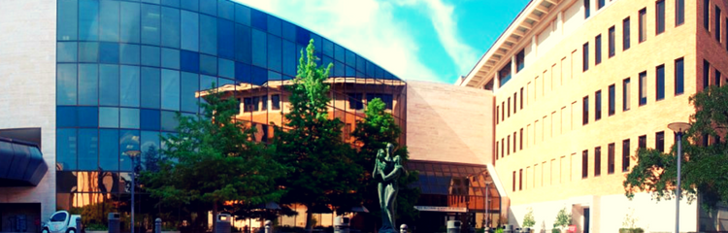
Importance
Immense Growth of Media Communication [2]
Classrooms, Healthcare, Businesses, Social Media, etc.
Free
Image Credit: https://www.mccombs.utexas.edu/~/media/Images/MSB/Centers/HealthcareInitiativeResponsive/Curriculum/2nd%20MBA%20Section%20Header%20-%2050%20Percent.png

Slide 5
Motivation
New and Not Fully Examined Specification
Lasting Impact on Computer Science and Real-Time Communication
Increase of Virtual Communication and Virtual Meetings [2]
Further Security
Mitigate Vulnerabilities

Slide 6
Security Concerns
Confidentiality Violations
IP Leaks
Potential Others Concerns [3]:
Cross-Site Scripting
Malware Facilitation
Multiple Sessions of the Same Connection
Credential Storage
Network Traffic Tampering
Relevance

Slide 7
Related Research
Knowledge Development [4]
Constructivism in Computer Science Education, Mordechai
Confinement Problem [5]
A Note on the Confinement Problem, Lampson
WebRTC Security and Weaknesses [3]

Slide 8
Problem Statement
“WebRTC has the foundation to allow for a secure and simple connection to be made by two users without installing native apps or plugins.”
Is WebRTC Susceptible to Covert Channels?
Mitigation Methods If So
Is WebRTC Susceptible to IP Leaks?
Possible Mitigation Method If So

Slide 9
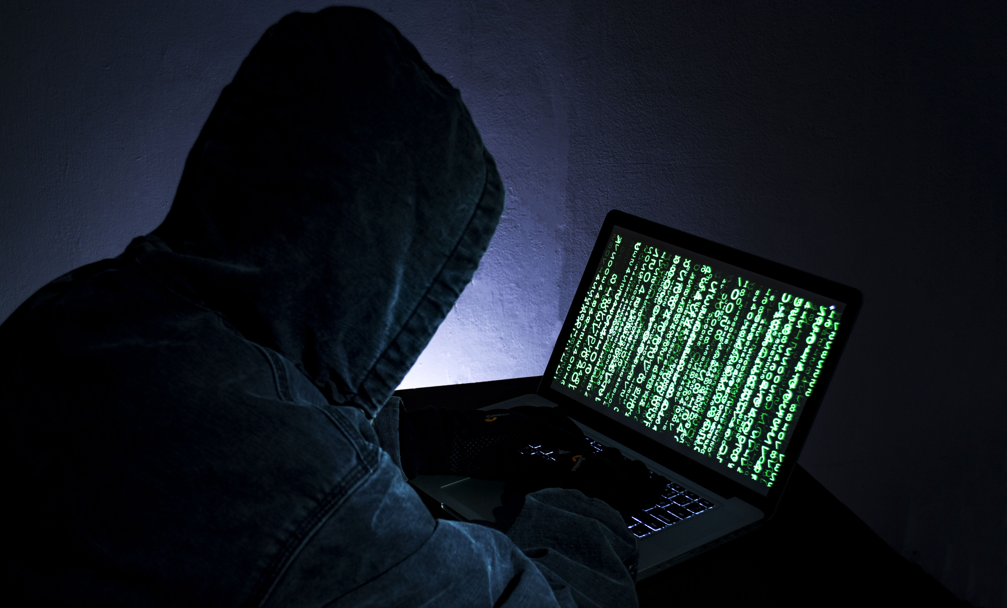
Confidentiality Violations
Peer-To-Peer Connection -> Real-Time Data
WebRTC API
Great for Development, Concerning with Hackers/Exploits
Covert Channels
Image Credit: https://betanews.com/wp-content/uploads/2015/03/freak_security_vulnerability.jpg

Slide 10
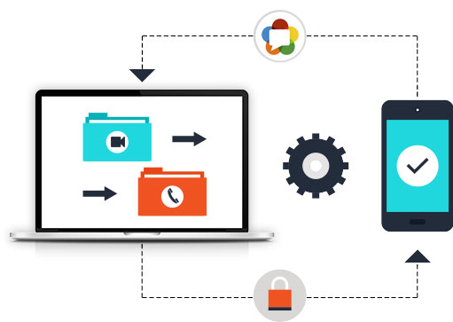
How WebRTC Works
Web Browser Specification [1]
Allows for Two or More Clients to Communicate in Real-Time
Involves a Web Server in which Protocols are Established to Send
and Connect Each Client’s Request/API Calls
Image Credit: https://fameglob.com/wp-content/uploads/2017/08/web_rtc_wht_we_do_graphic.jpg

Slide 11
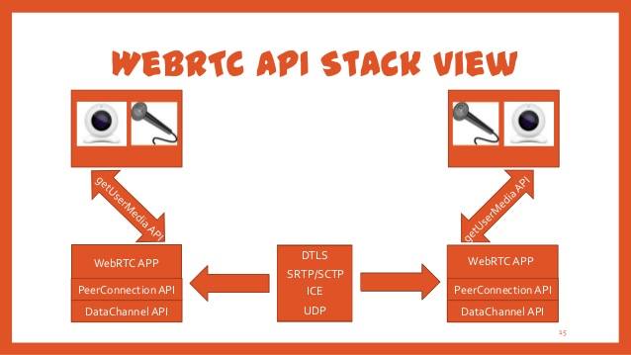
WebRTC API
Detailed & Resourceful
Research ► Examples ► Prototype
JavaScript & HTML5
Image Credit: https://image.slidesharecdn.com/webrtcup-130320110314-phpapp02/95/webrtc-15-638.jpg?cb=1363777440

Slide 12
Covert Channels
Sending Data Unintentionally
Can be Harmless/Harmful
Threat
Sending Sensitive Data
Malware

Slide 13
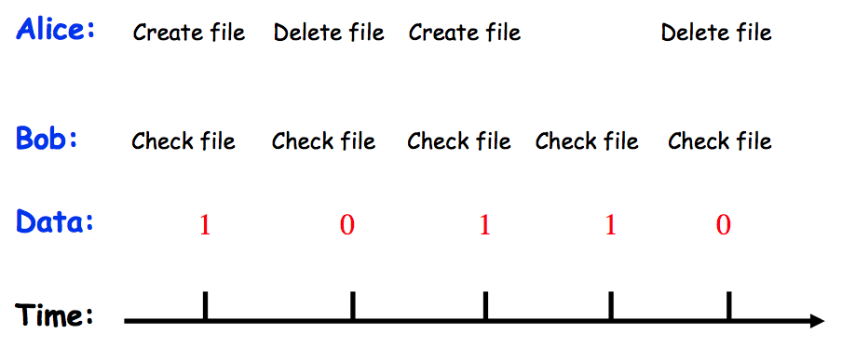
Covert Channels – How They Work
Exploit Certain Elements (WebRTC API) to Send/Receive Data
Image Credit: http://www.cs.sjsu.edu/faculty/pollett/166.3.12f/LectureImages/CovertChannel.png

Slide 14
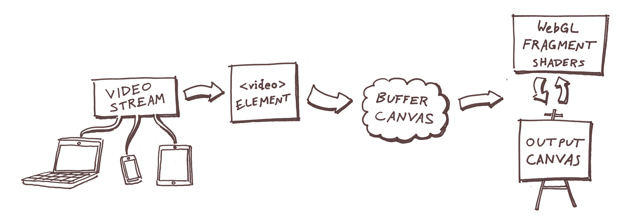
Covert Channel Implementation
via Image Filtering: JavaScript Method [6]
Local ► Remote
Local ► Canvas (Delay Implementation) ► Remote
Image Credit: https://sudo.isl.co/webrtc-real-time-image-filtering/

Slide 15
Research Method
Effectiveness of Exfiltrating Information via Covert Channels
Error Rate & Covert Channel Bandwidth
Higher CCB may result in more data, but an increase in error rates
Two Prototypes
Unsecure ► Covert Channels without Mitigations
Secure ► Mitigating Covert Channels
Black Screen/”Sample Presentation” Method – 10 Separate Tests for Each Graph (Test)

Slide 16
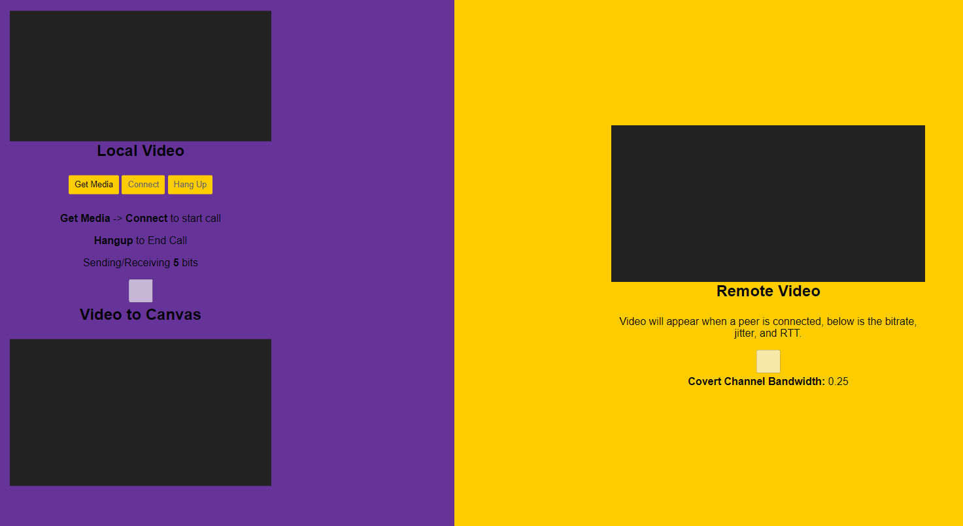
Unsecure Prototype
Covert Channel ► Send & Receive a Bit
Implement Delay ► Sense the Delay ► Receive Bit
Error Rate
Covert Channel Bandwidth
T or Input Rate

Slide 17
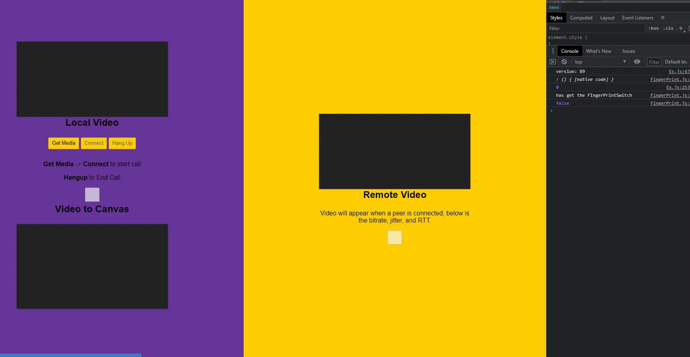
Unsecure Prototype - Demo

Slide 18
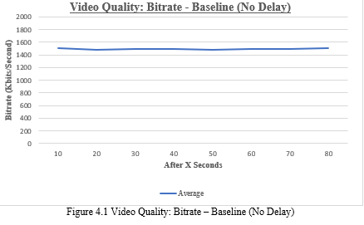
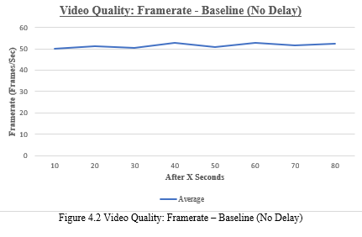
Results (Unsecure) - Baseline

Slide 19
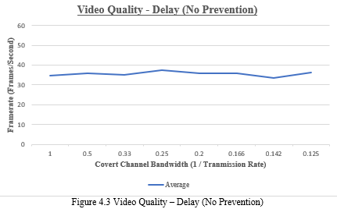
Results (Framerate) – Baseline vs Unsecure

Slide 20
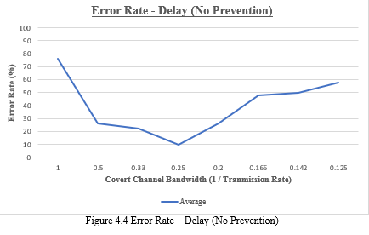
Results (Error Rate) – Covert Channels

Slide 21

Secure Prototype - Mitigation
Expand Unsecure Prototype - Mitigate Covert Channels with Delays
Constant Delay
Random Delay
Simulate Control by Admin
Performance Concerns
Increase in Error Rate

Slide 22
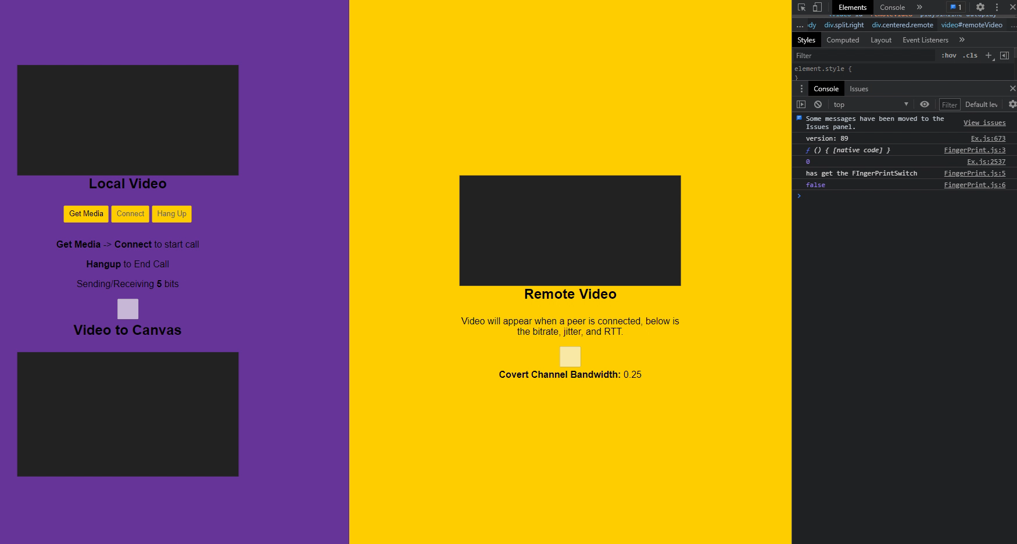
Secure Prototype - Demo

Slide 23
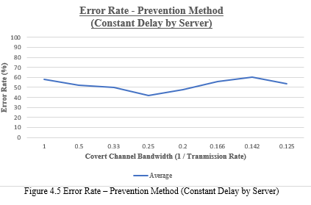
Results (Error Rate) – Constant Delay: Secure

Slide 24
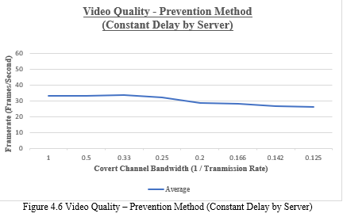
Results (Framerate) – Constant Delay: Secure

Slide 25
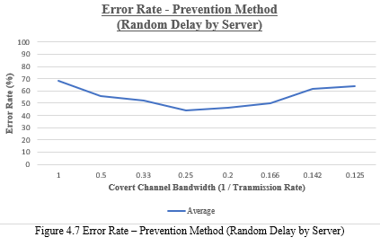
Results (Error Rate) – Random Delay: Secure

Slide 26
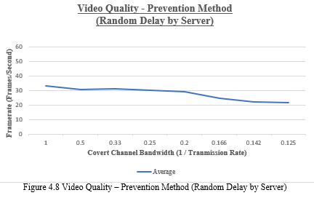
Results (Bitrate) – Random Delay: Secure

Slide 27
IP Leaks
Public IP Address of Each Client is Required to Connect [7]
Geographical Location via Public IP Address
Public IP is Required Through STUN/TURN Protocols
Google Implementation
Image Credit: https://betanews.com/wp-content/uploads/2015/03/freak_security_vulnerability.jpg

Slide 28
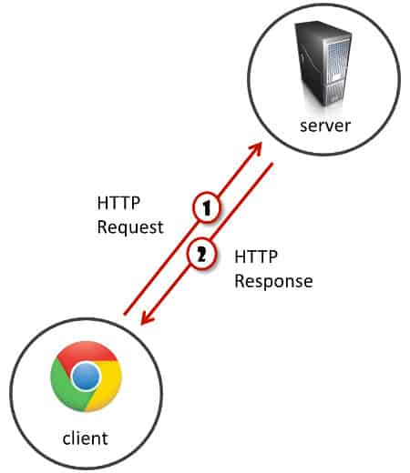
WebRTC Current Approach: Server Implementation
STUN/TURN Protocols
Web Sockets
Image Credit: https://bloggeek.me/wp-content/uploads/2017/11/201711-client-server.jpg

Slide 29
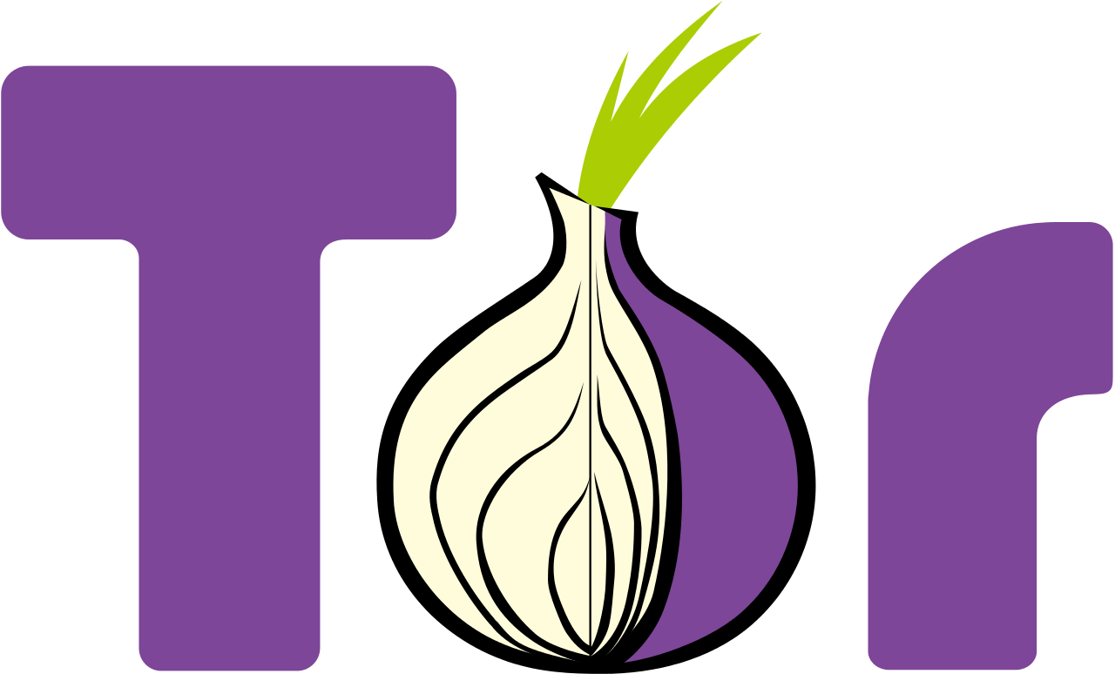
WebRTC New Approach: Distributed Hash Table
Mitigating IP Leaks
Distributed Hash Table Server
Seen with TOR
No Central Server
Relay nodes
Image Credit: https://www.loudtechie.com/wp-content/uploads/2015/08/Tor-logo-2011-flat.svg_.png

Slide 30
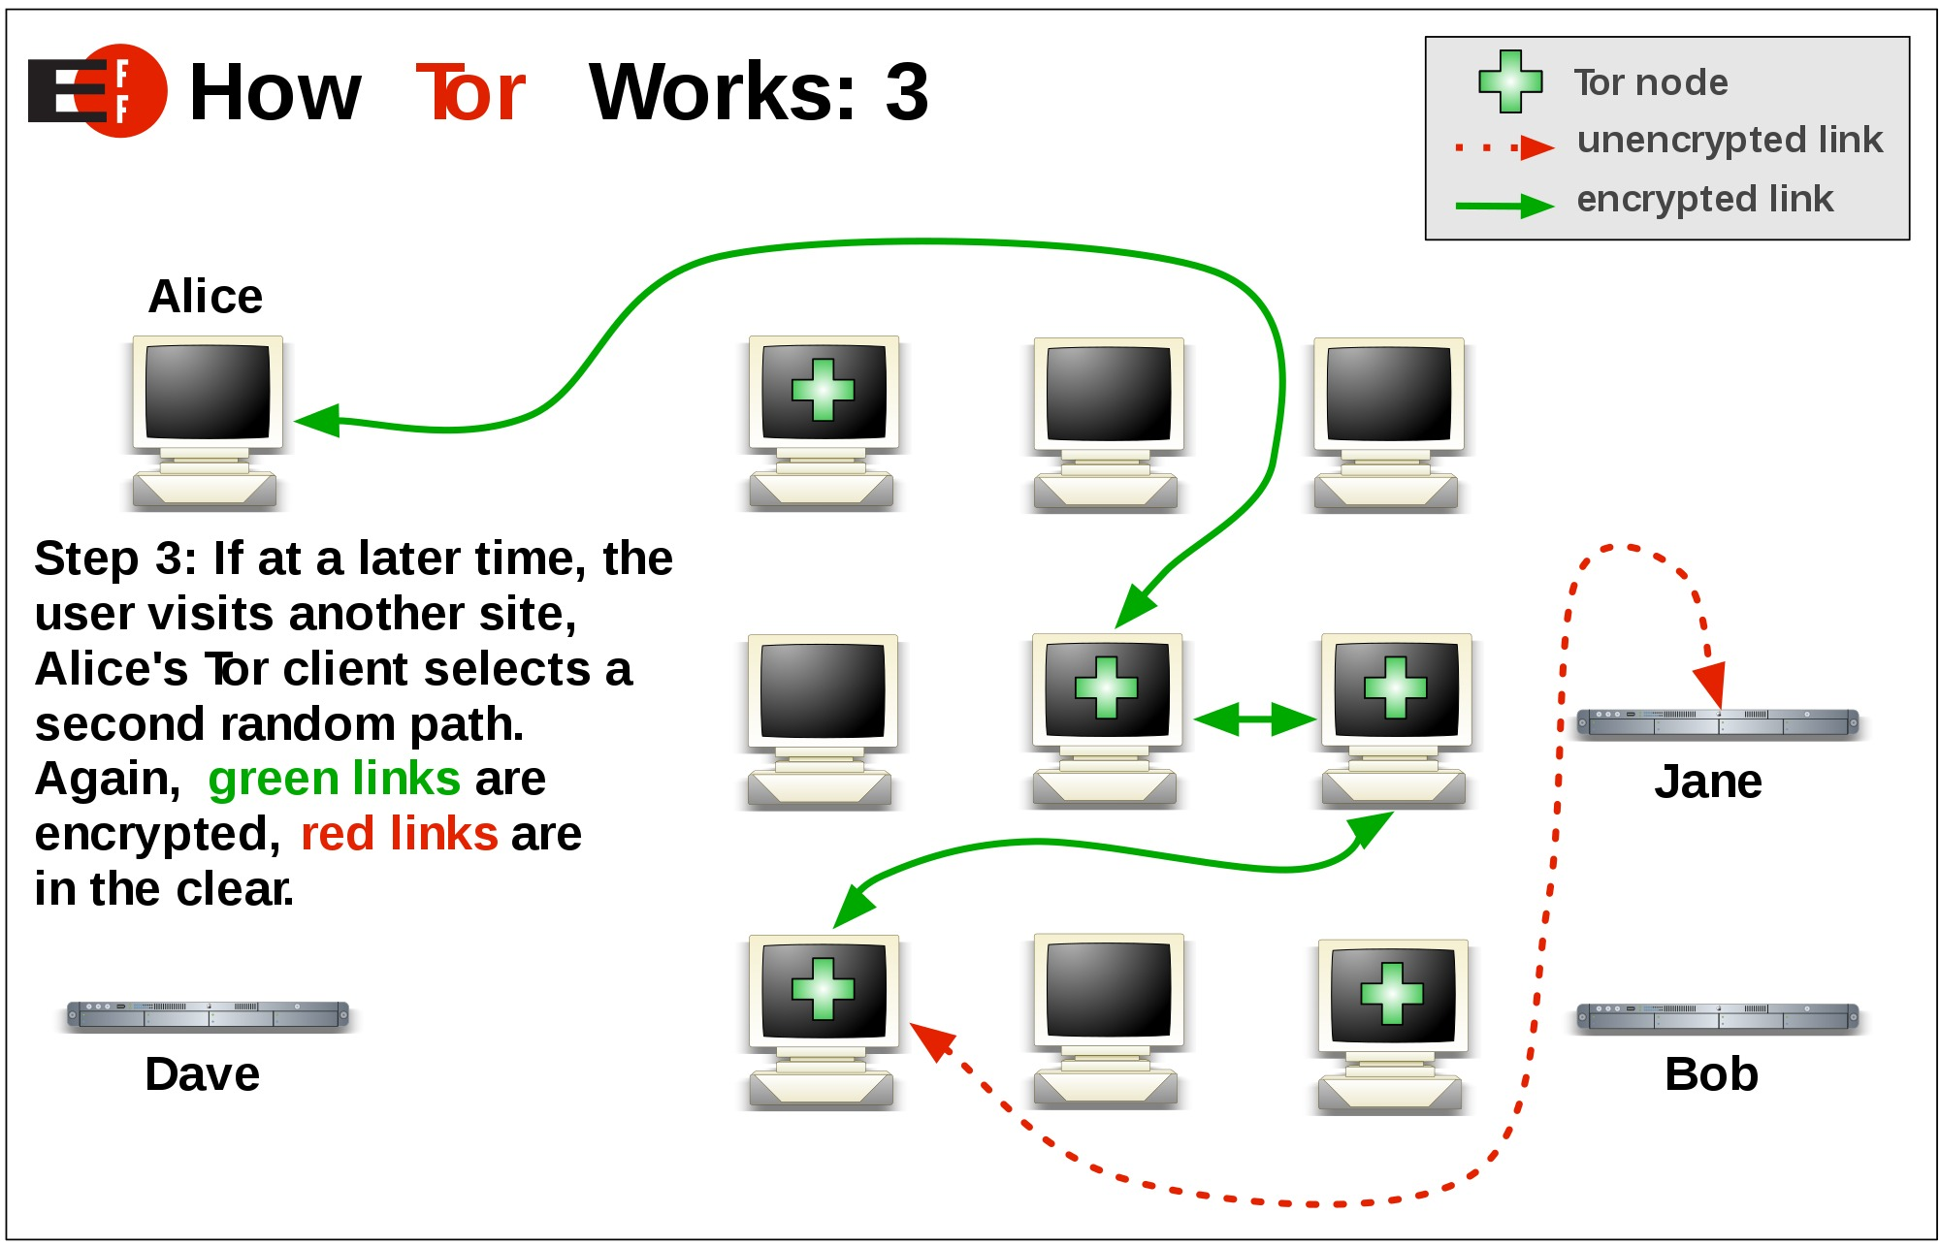
DHT Implementation
Image Credit: https://images.idgesg.net/images/article/2018/07/tor-3-100763520-orig.jpg

Slide 31
Conclusion
WebRTC is susceptible to Covert Channels
Image Filtering using the Canvas Element allows Fluctuating Bitrates
Bits can be sent, and received
Attempted Two Mitigation Methods of Delay Mechanisms
Constant
Random
WebRTC is susceptible to IP Leaks
Possible Mitigation Method is a Distributed Hash Table Implementation

Slide 32

Future Work
Extension of the Study to Actual Network Environment
Our Validity
Validity of Our Implementation
Prototype Implementation of DHT
Development, Testing, & Analysis
Image Credit: https://www.kochiesbusinessbuilders.com.au/wp-content/uploads/2017/10/robot.jpg

Slide 33
References
[1] B. Jansen, T. Goodwin, V. Gupta, F Kuipers, G. Zussman, “Performance Evaluation of WebRTC-based Video Conferencing,” in Performance Evaluation Review, ACM, vol. 45, no. 3, pp. 56-68, 2018.
[2] K. Stone, (2020, July 7). The State of Video Conferencing in 2020. [Online]. Available: https://getvoip.com/blog/2020/07/07/video-conferencing-stats/
[3] R. Puzis, “WebRTC Security Measures and Weaknesses,” in International Journal of Internet Technology and Secured Transactions, 2018.
[4] B. Mordechai, “Constructivism in Computer Science Education,” in Proceedings of the Twenty-Ninth SIGCSE Technical Symposium on Computer Science, SIGCSE ’98, pp. 257-261, 1998.
[5] B. Lampson, “A Note on the Confinement Problem,” in Comunications of the ACM, 1973.
[6] Donaldson, Scott (2018, April 10). Using WebRTC for Real-Time Image Filtering. [Online]. Available: https://sudo.isl.co/webrtc-real-time-image-filtering/
[7] A. Reiter, A. Marsalek, “WebRTC: Your Privacy is at Risk,” in Proceedings of the Symposium on Applied Computing, SAC ‘17, pp. 664-669, 2017.

Slide 34

Questions?
Image Credit: https://i.pinimg.com/originals/66/1a/08/661a08971315878673a562cd5f2c7220.jpg

